Slide 1
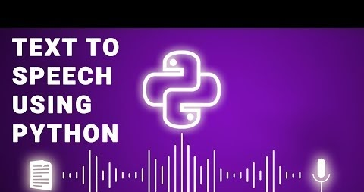

Slide 2

Submitted to :
Department of Computer Applications,
KIET Group of Institutions,
Delhi-NCR, Ghaziabad
Submitted by
Group No.:
Anshul Yadav – 2100290140030
Divya Gupta -2100290140062
KM. Purnima - 2100290140075 Under the supervision of :
Sangeeta Arora
Associate Professor

Slide 3
INTRODUCTION
A Text-to-speech synthesizer is an application that converts text into spoken word, by analyzing and processing the text using Natural Language Processing (NLP) and then using Digital Signal Processing (DSP) technology to convert this processed text into synthesized speech representation of the text.

Slide 4
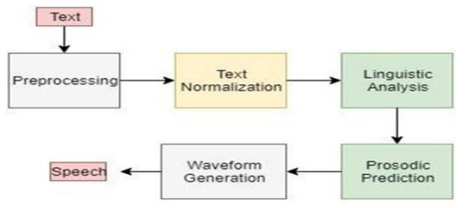
In Text-To-Speech conversion the input text is analyzed and then this text is converted into its audio version to play. This functionality has an effective advantage when a person understands a language but is not fluent with reading and writing in that language and is also useful for the people who are visually impaired as they cannot read but understand the message by hearing it.

Slide 5
TECHNOLOGY USED:
The technologies used for developing this program is :
PYTHON

Slide 6
SOFTWARE REQUIREMENTS
The software environment used for developing the application is:
⦁ Operating system – Windows 10/11 or Ubuntu +
⦁ Code editor- Microsoft Visual Studio Code

Slide 7
HARDWARE REQUIREMENTS
Hardware components required for installing all the requirement and tools are:
⦁ Processor – Intel i3 5th generation or higher.
⦁ RAM- Minimum 4GB of free disk space

Slide 8
MODULES
All these modules are created by the help of tkinter or pyttx3 in python.
The modules present in the application are:
⦁ Frame
⦁ Text
⦁ Voice Gender
⦁ Voice Flow
⦁ Output(Voice)
⦁ Save voice

Slide 9
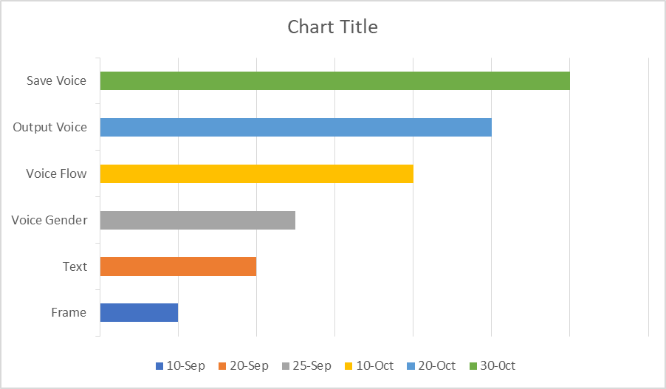
GANTT CHART

Slide 10
CONCLUSION
A text to speech is a python based GUI used Tkinter or pyttx3 modules that convert a text into voice. This system is of text to speech can be implemented for a English language only.
We can actually mediate and fill the lacuna provided by not fully exploiting the capabilities of some handicapped individuals. It is never been so easy to use a text-to-speech program as you just one click and your computer will speak any text aloud in a clear natural sounding voice.

Slide 11

HOW TO SERVE THE SOCIETY
This system can be deployed for the purpose of effective communication by normal, illiterate and visually challenged people.
It will create a balance and provide fare chance to show the skills .
It will be beneficial for the old and visually challenged people to establish communication and easily adopt the changed environment.

Slide 12

THANK YOU

